Slide 1

DCM T4: Alzheimer’s Risk
Anthony Campitelli

Slide 2


ANU-ADRI
This is the big survey you take on-site at the beginning of each testing session
Designed to quantify Alzheimer’s risk
A composite of risk and protective factors
Score of 0 is baseline risk for the population
Higher scores mean more risk
Lower (negative) scores indicate protection

Slide 3
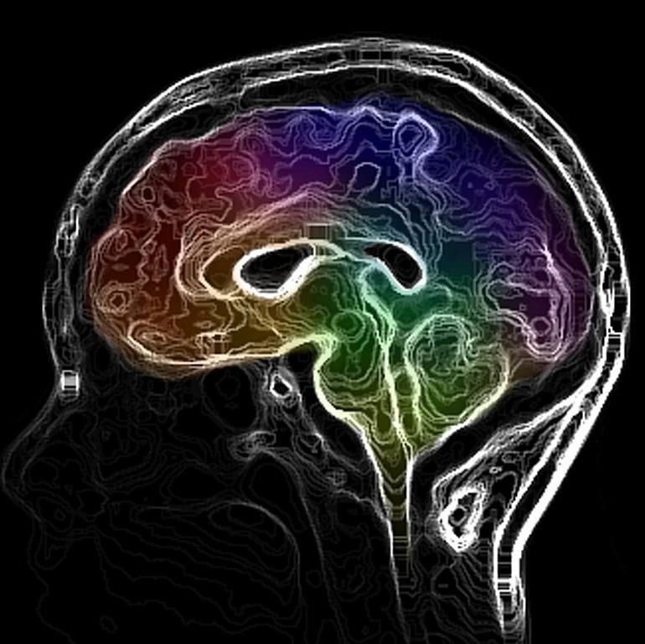
ANU-ADRI
Summary:
You were a very healthy population to begin with!
Risk did not increase despite an increase in age
The highest risk participants lowered their risk substantially over the course of the study
Both HC and HE were effective for stabilizing and, in certain cases, actually reducing risk!

Slide 4
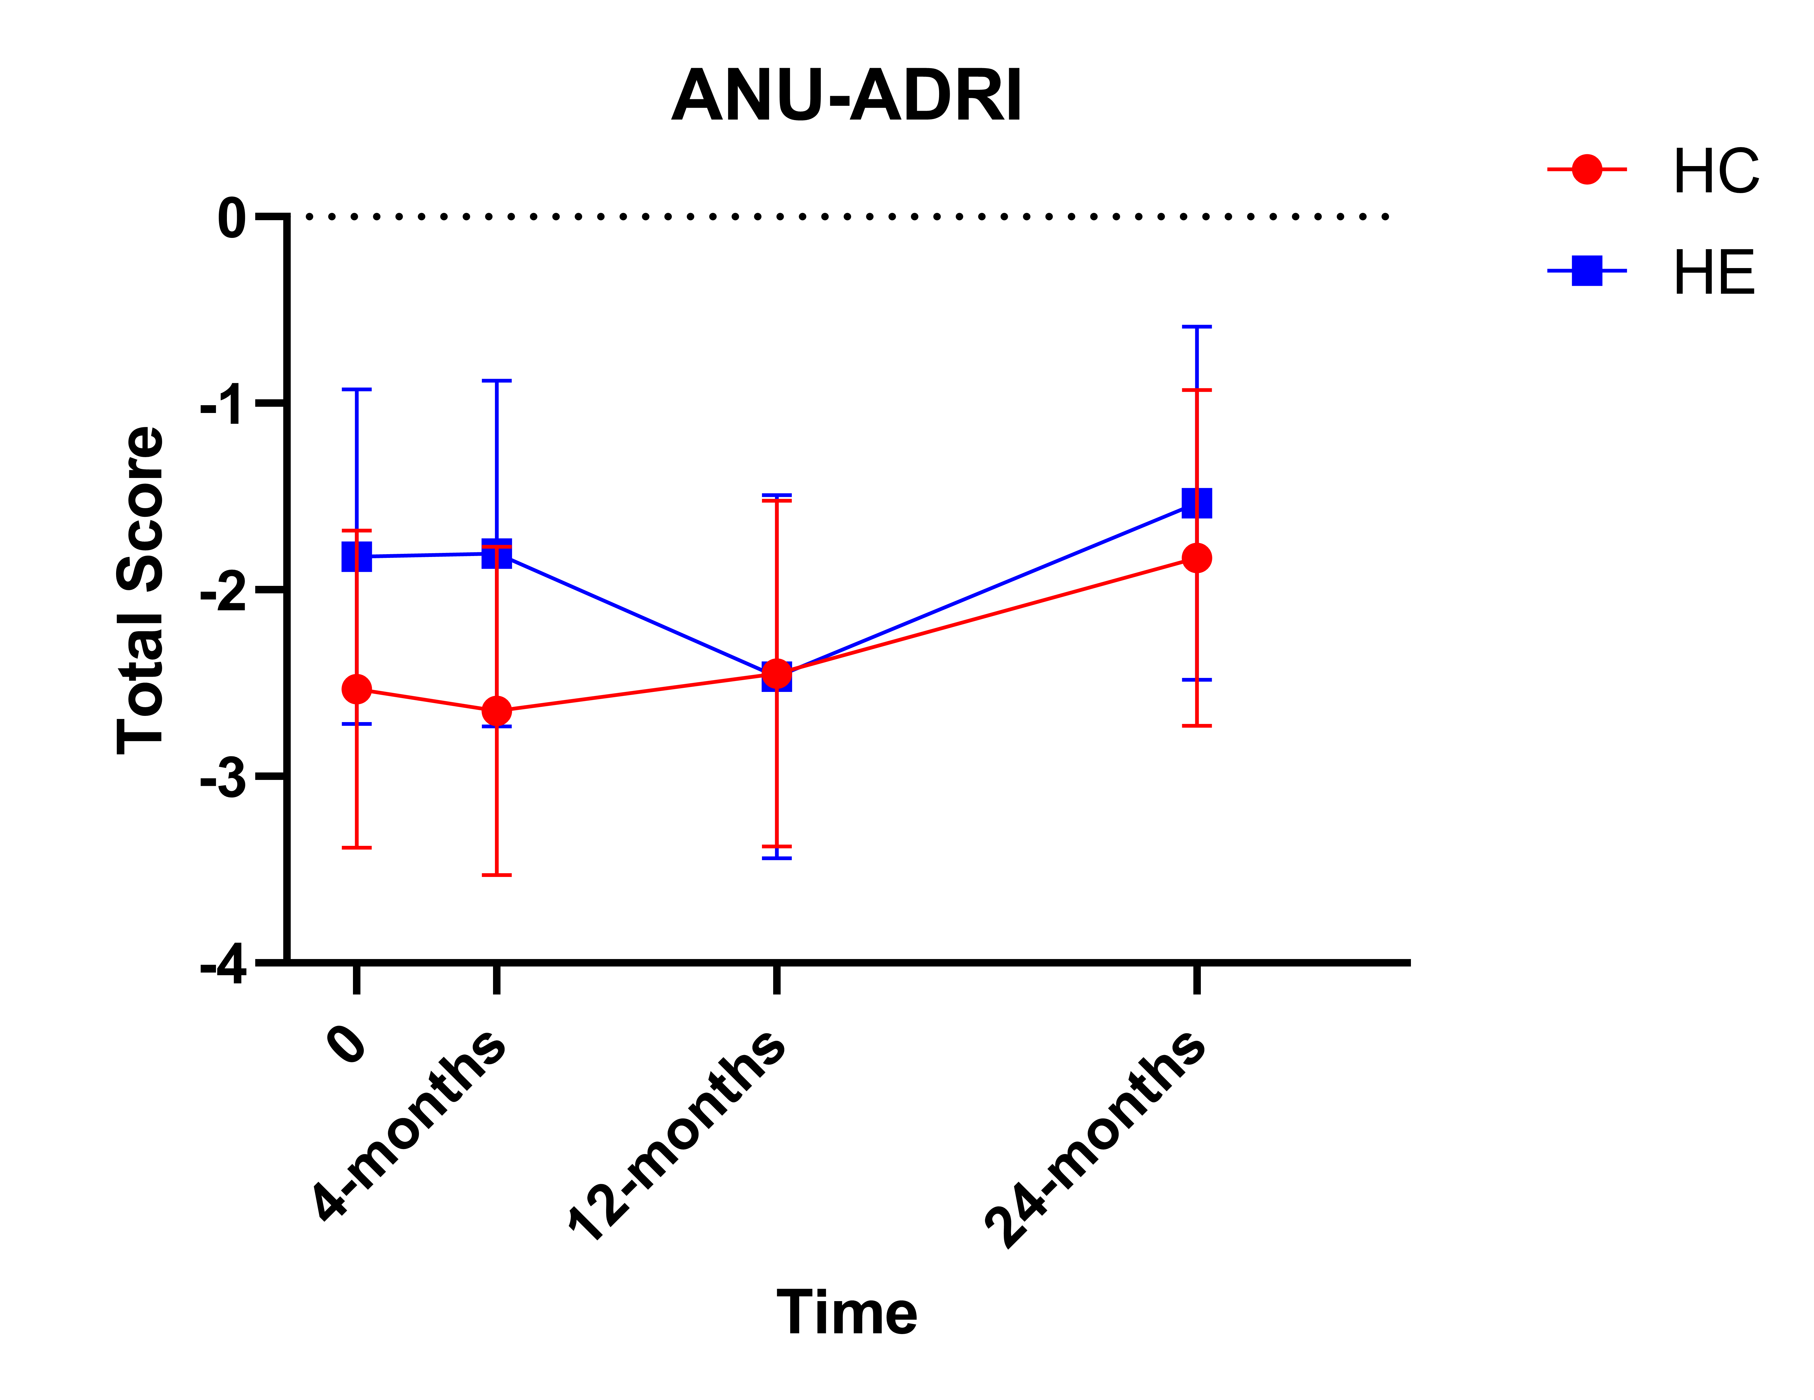
ANU-ADRI Total Score

Slide 5
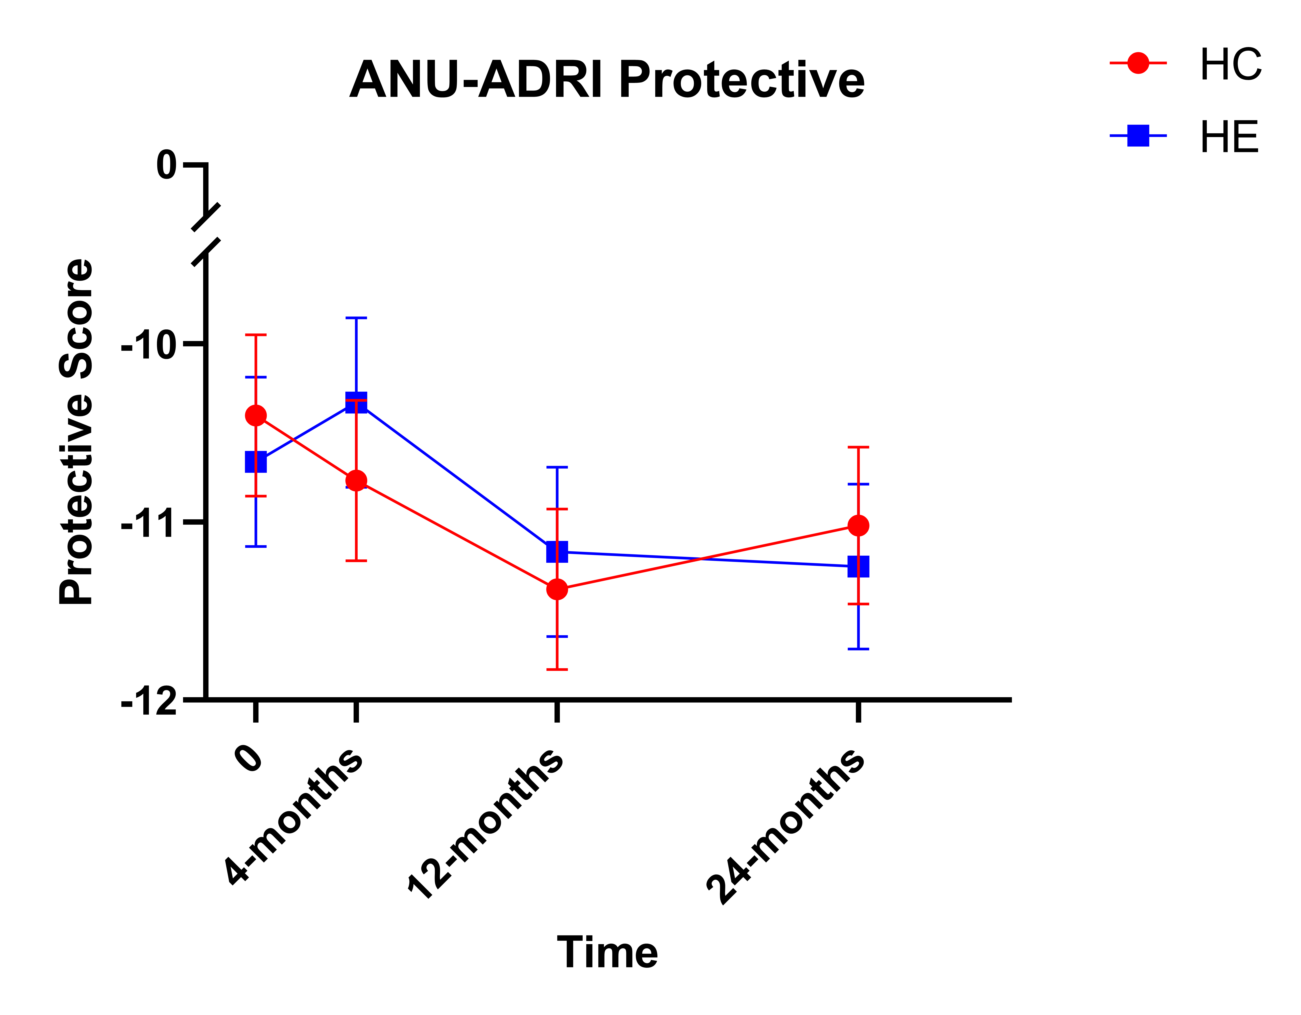
ANU-ADRI Protective Score

Slide 6
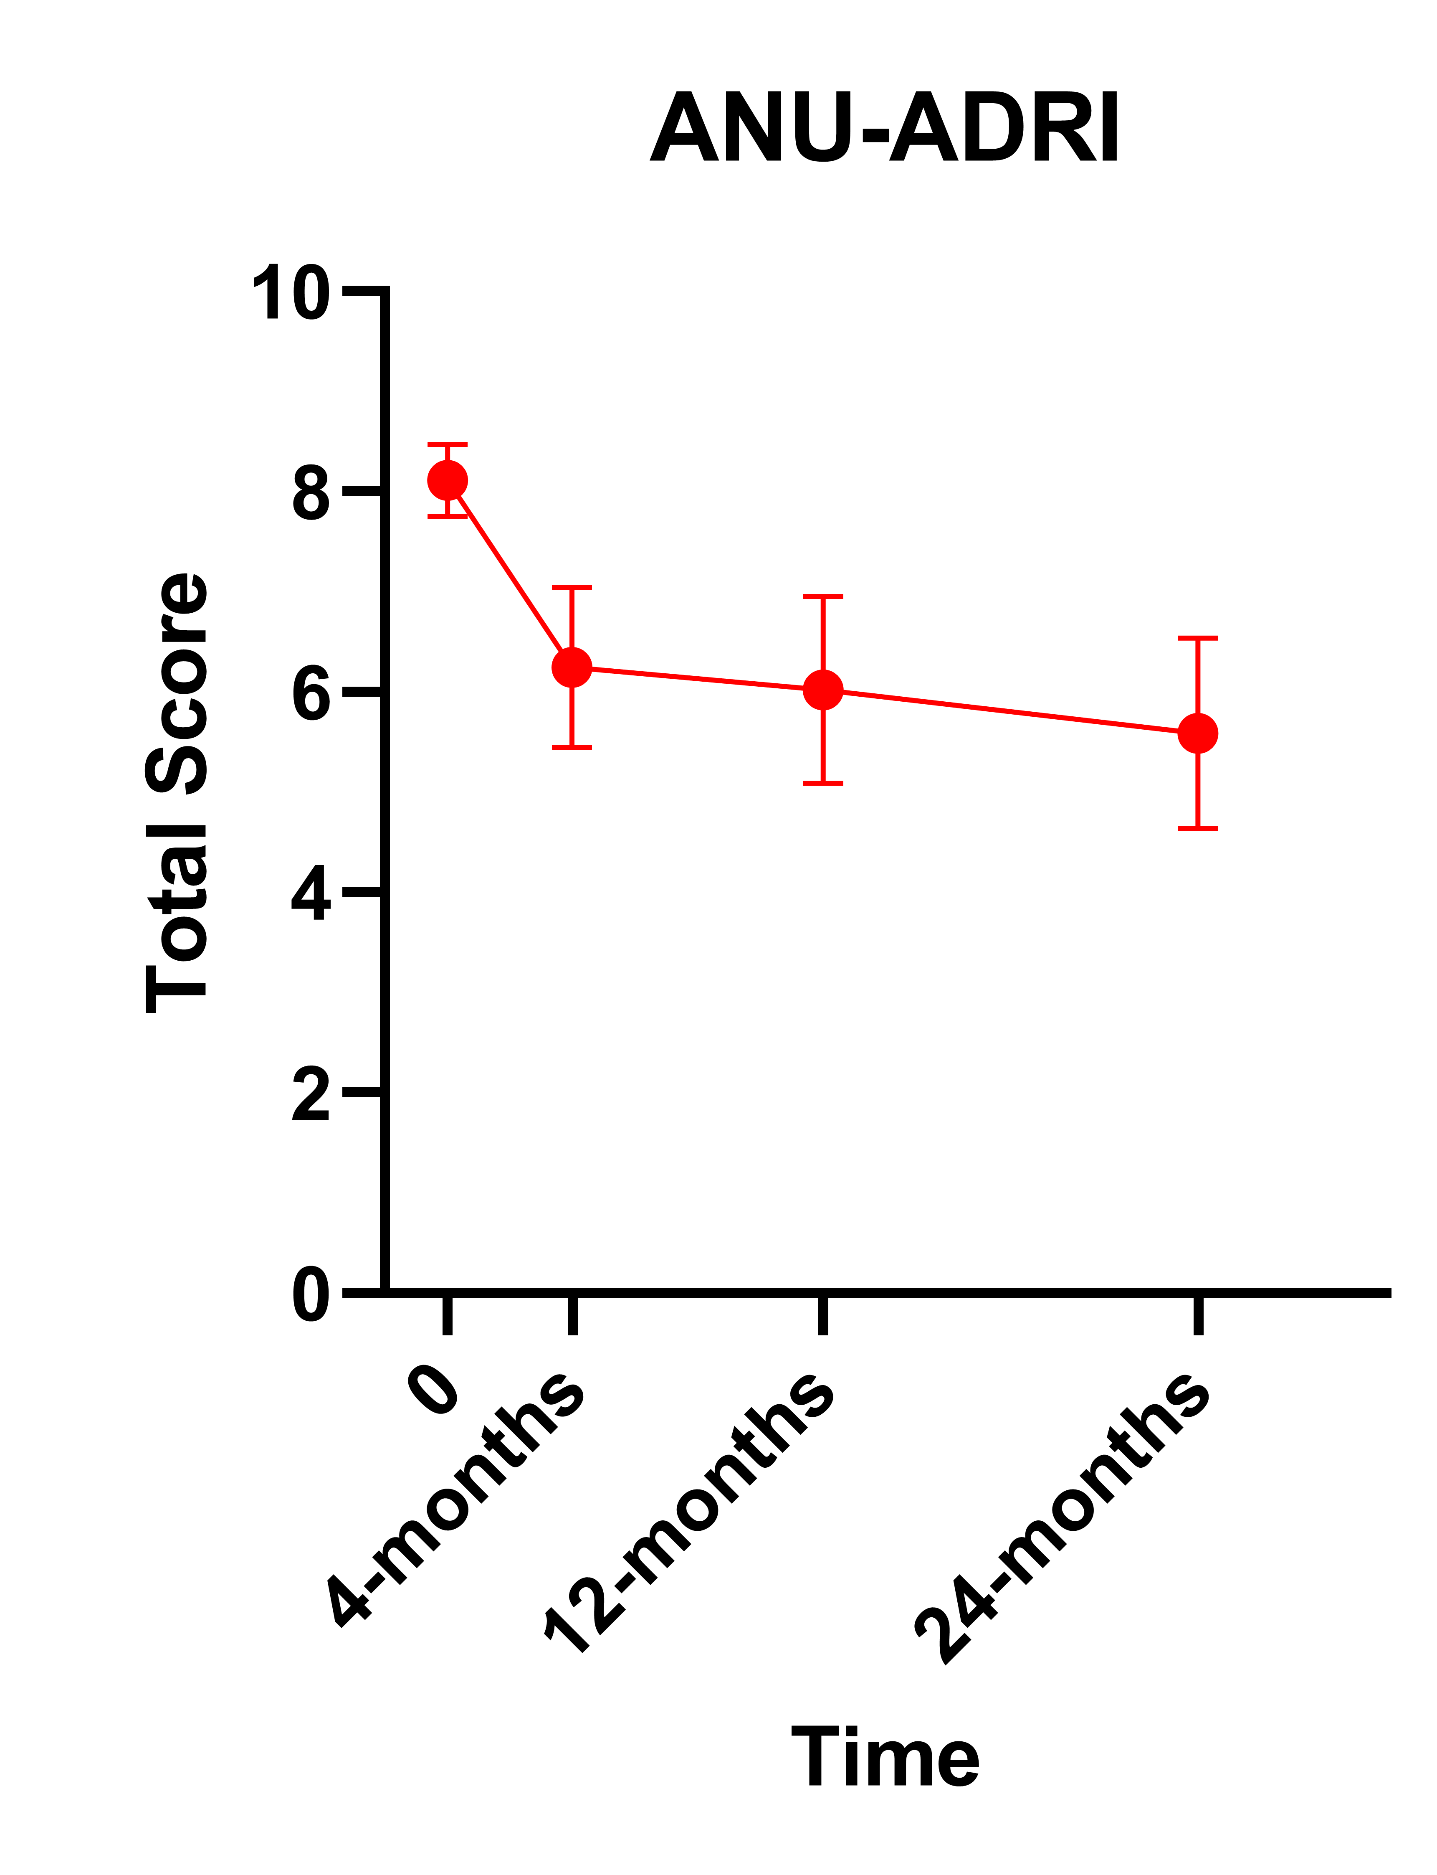
ANU-ADRI by Quartile

Slide 7




Conclusion
Very strong initial improvements in protection against AD with subsequent long-term maintenance
When an outcome improved, HC and HE appeared to be equally effective
The interventions were effective regardless of the sex or age of the participants
The population at greatest risk improved the most

Slide 8

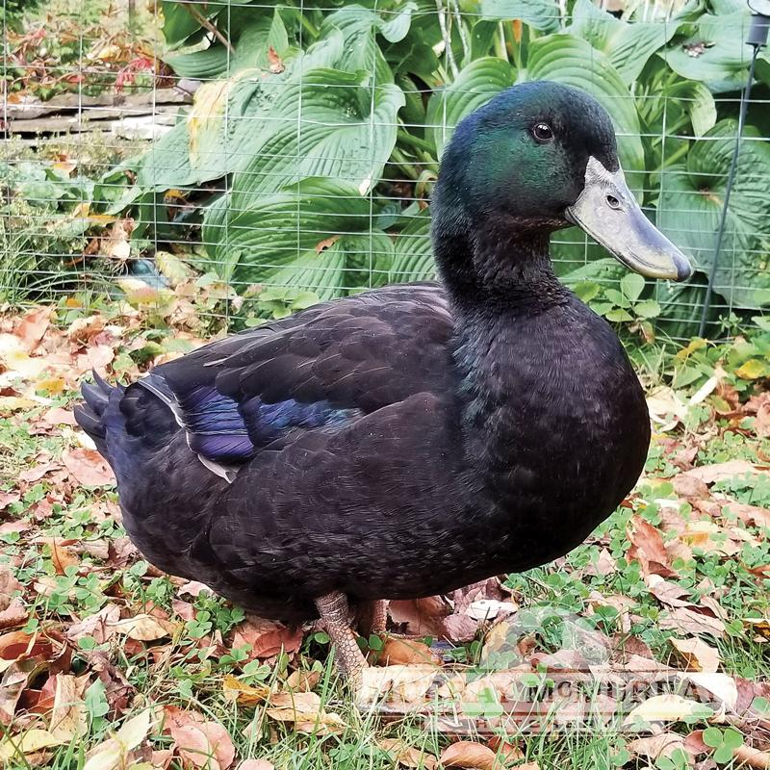
Questions?
? ? ?
Quack?

Slide 9


Thank you
Anthony Campitelli
amcampit@
uark.edu

